Slide 1
Squeeze Excitation Embedded Attention UNet
John Rohit Ernest
Gaurav Prasanna
Lalitha G

Slide 2
Introduction
Deep Learning based techniques have gained significance over the past few years in the field of medicine. They are used in various applications such as classifying medical images, segmentation and identification. In this paper, we propose a new network called SEEA-UNet which stands for Squeeze Excitation Embedded Attention UNet, this architecture has both Attention UNet and Squeeze Excitation Network for better results and predictions, this is used mainly because to get information at both Spatial and channel levels. The proposed model was compared with the existing architectures such as UNet, Attention UNet and Attention Residual UNet, based on the comparison it was found out that for lesser number of epochs trained, the proposed model performed better and Binary focal loss and Jaccard Coefficient were used to monitor the model’s performance. We achieved an Jaccard Coefficient of 0.0721 in the validation data.

Slide 3
Proposed Methodology
Collection of dataset from Kaggle
Segmentation dataset(725 images and masks)
Unet, Attention Unet and Attention ResUnet
Segmentation Results
Development of new Architecture

Slide 4
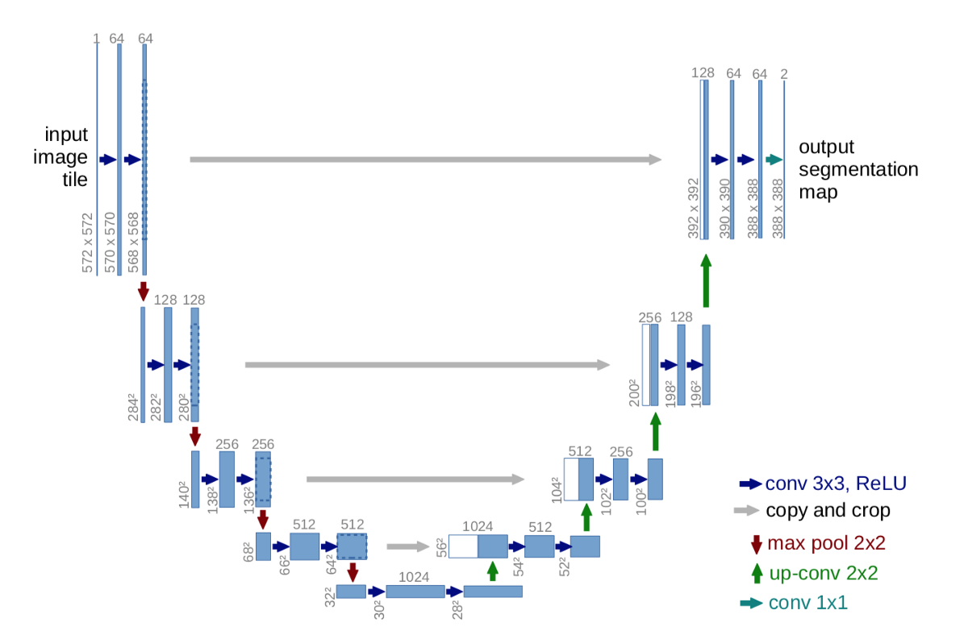
UNet Architecture

Slide 5
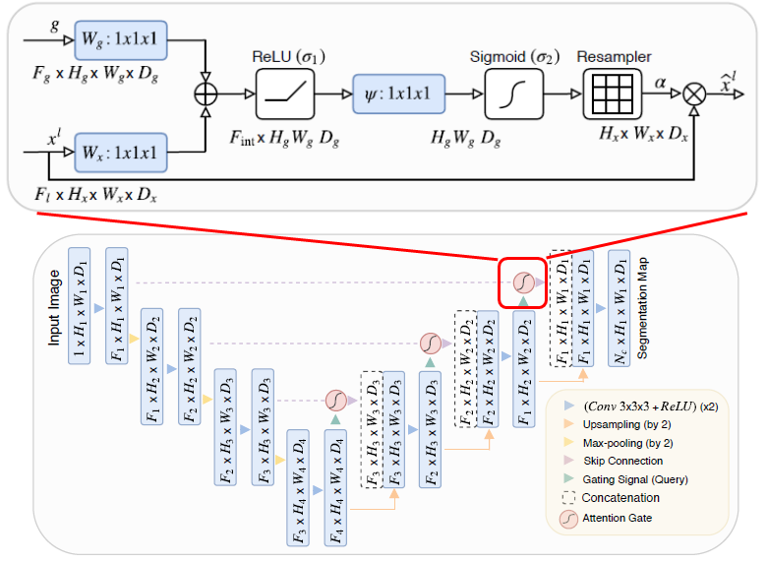
Attention UNet

Slide 6
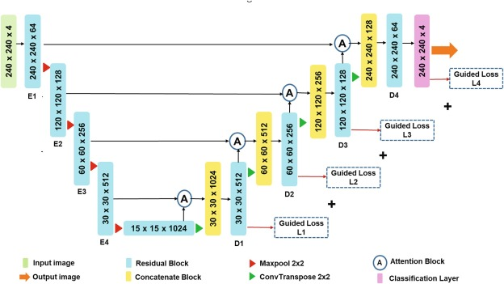
Attention ResUNet

Slide 7
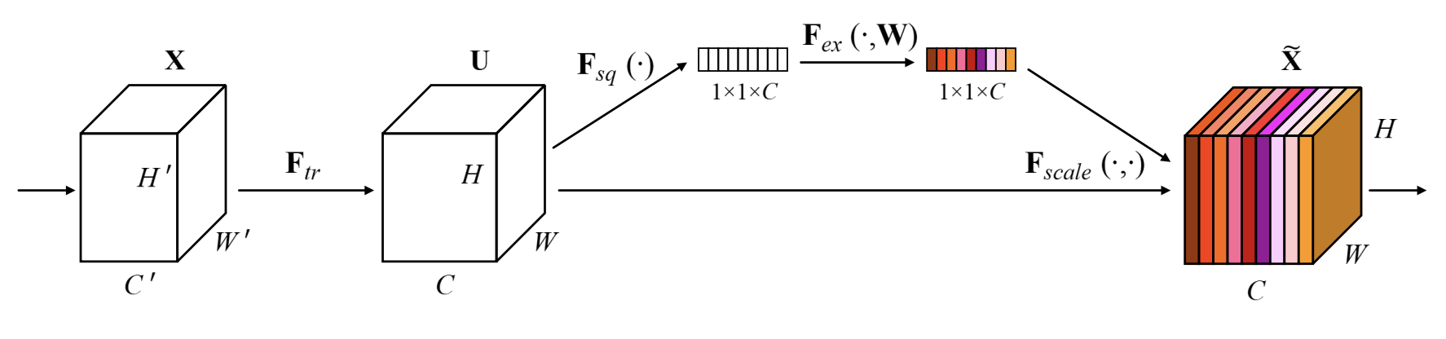
Squeeze-and-Excitation Block

Slide 8
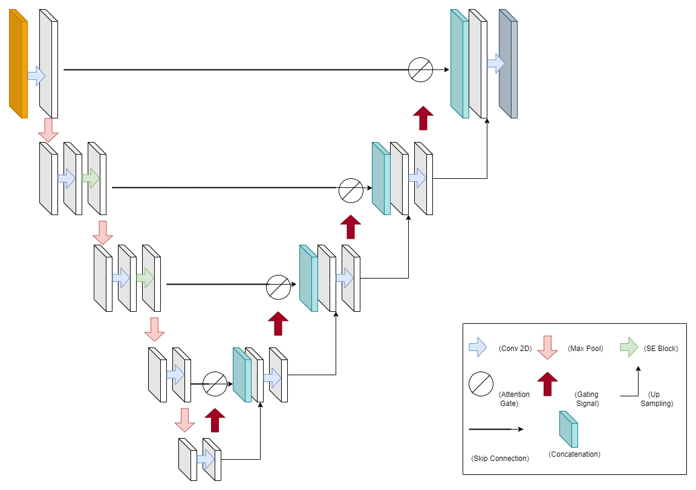
SEEA-UNet

Slide 9
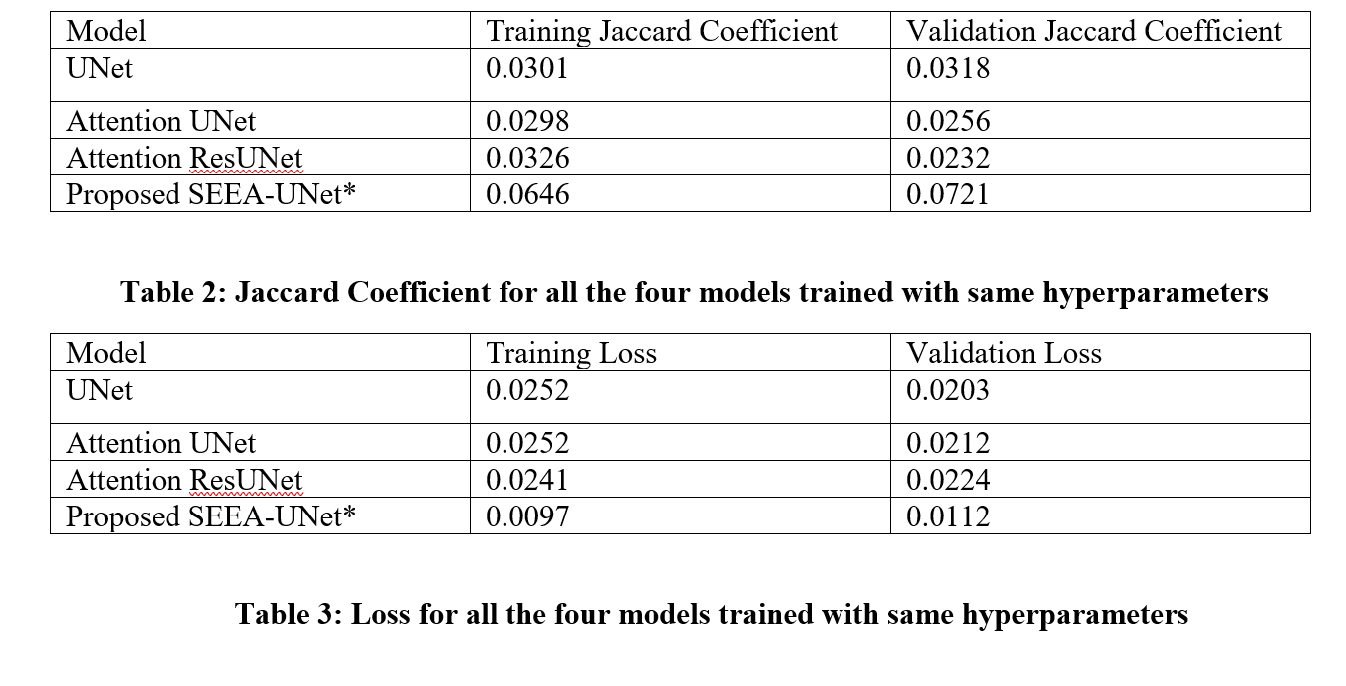
Jaccard Coefficients and Binary Focal Loss

Slide 10
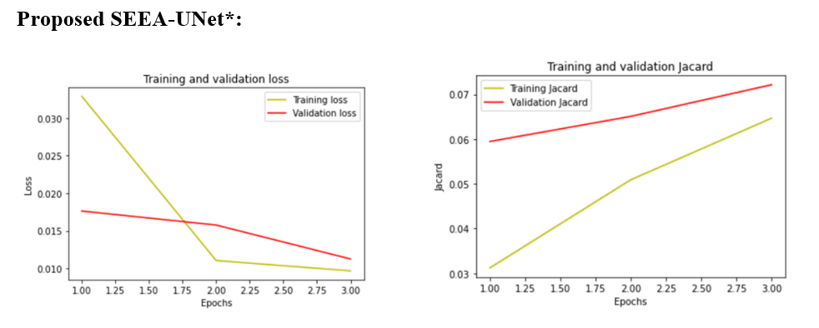
Proposed SEEA-UNet

Slide 11
Conclusion
Overall, in this paper we try to prove that having a double attention-based scheme one that of Squeeze and Excitation Network based and other having soft attention mechanism by incorporating Attention gate and gating signal could very well serve as a benchmark for biomedical image segmentation. Not just solely focused on Brain Tumor Segmentation, addition to this could be incorporating more layers into the network and then test it in on different benchmark datasets and see how it performs on varied scales, and not just focusing on modified UNet. As further study this model can also be checked on 3D Medical Imaging Dataset[16] and how well it is able to perform even in lesser number of epochs and varying the hyperparameters to see how it performs. on adding more layer this could very well lead to improvement in performance and aim at higher Jaccard coefficient and also bring the loss to a very negligible value. Lastly, we would like to thank Dr Muthu Subhash Kavitha for the guidance and support along the way, and also to Dr Sreenivas Bhattiprolu from whom we had taken a lot code references from his tutorial and Github repository and also Research Scholar Premanand for his guidance and support while debugging the code.

Slide 12
THANK YOU

